Slide 1
Iterative SRE Transformation
Christina Yakomin
Vanguard
Notes:
25-30 minutes

Slide 2

Global asset manager
> $7 trillion global AUM
> 17,000 crew members

Slide 3

Christina Yakomin
Site Reliability Engineering Coach
AWS Certified
Experience with full-stack application development and cloud infrastructure automation
Chaos engineering enthusiast
Member at the Philadelphia Zoo

Slide 4
Where we started
Private Data Center
Controlled deployments
Alert-only visibility
Development and Operations
Notes:
5-7 years ago….
Private Data Center
Monolithic apps, no public cloud presence
Controlled deployments
Quarterly releases, dev teams can't deploy
Alert-only visibility
No dashboards, no positive affirmation of function, central ownership of alerts
Development and Operations
Completely separate silos for dev and ops, centralized production support
Context
Some microservices, some product teams, a little bit of DevOps but not true infra ownership (mostly legacy, with some microservices on a PaaS private cloud)
No public cloud footprint. Almost entirely in our data center that we owned
Observability
Alert-only visibility – are they running? If not, alert. Can we hit the page every 5 minutes? If not, alert. If no alerts, we must be fine.
This is obviously bad. We really should be able to get some positive affirmation that things are working. How well are they working?
Alerting was centrally managed – team submits a request to a central team to have an alert configured for them
Notification platform was not great
Incident Management
PCoE teams (prod support) always get first notification, maybe pull in app teams later

Slide 5
Cloud Migration
From data center to public cloud

Slide 6
Breaking down the monolith
Couldn’t lift and shift
Carved out microservices
Increased deployment frequency
Notes:
Couldn’t easily lift and shift most of our apps
Slowly started carving out microservices, running on a private cloud PaaS internally
As part of this, improve deployment frequency:
Regression cycle was so long, reduced it
Test automation engineer role introduced
A new pipeline to run the automated tests
Tied deploy frequency to microservice development at first
Automatically generated change records
Attached test evidence

Slide 7
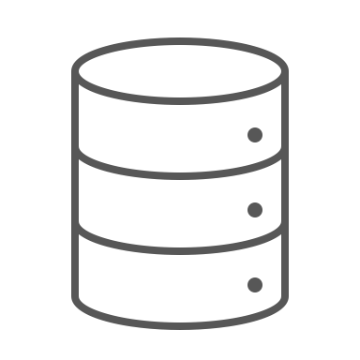

Lift and Shift our PaaS
Notes:
Put the private cloud in the public cloud
This was HARD for the infra teams, but helped app teams a lot
Ultimately left us with a now-unnecessary abstraction layer that was overcomplicating the environment and causing more problems than it solved

Slide 8



Moving to cloud-native solutions
Notes:
A more cloud-native solution
Remove the abstraction layer from our purview
Leverage ECS Fargate for similar experience (low complexity) without the operational overhead of maintaining PaaS
Ultimately, provide multiple choices for cloud compute: Lambda, ECS, EKS depending on what is the best fit for the workload

Slide 9

With great power comes great responsibility…
Notes:
Product teams need to test their configurations thoroughly
Adoption of new processes day-to-day
Failure Modes and Effects Analysis
Chaos Engineering
Performance Testing as a Service

Slide 10
DevOps Successes
Chaos Game Day
Developed hypotheses about system resilience
Caused crashes and validated scaling and self-healing
Chaos Fire Drill
New observability tools promised easier troubleshooting
Injected failures to put the new tools to the test
Break Testing our CI/CD Pipeline
Recurring instability observed at high-traffic times
Re-created the condition to spot the bottleneck
Crashes prevented thorough investigation

Slide 11
Observability Journey
Finding the right tools for the job

Slide 12
Looking at Live Data
Legacy alert consoles
Initial “live” dashboards from logs
Standard microservice platform dashboards
Addition of cloud logs and metrics
Increased custom dashboards
Notes:
Operations teams had dashboards but application teams did not, and even the ops dashboards were more like alert consoles
Central microservice platform team developed standard application dashboards with dropdown menus, microservice teams used them
Slowly over time, microservice teams started to customize, especially once cloud migration began in earnest
Following cloud migration, both logs and metrics data were available in the same tool, teams took advantage of this to build dashboards to monitor application performance and availability
Sometimes, dashboards were more likely to create confusion than solve problems. If engineers didn’t understand the underlying data, they might misread the info presented and make the wrong decisions about how to proceed. Important to be able to drill down into the data & queries behind panels.
From there, alerts built into the same tool as well.
The Timeline
Legacy Alert Consoles
Mainly limited to infrastructure operations teams
Initial “live” dashboards from logs
First focus was on logons and response time for core monolith web applications
This is where we started to consider signals of health (logins, etc) and started to move away from just CPU, memory and up/down.
Standard microservice platform dashboards
As we adopted microservices, those logs were added to the platform
Central microservice platform team developed standard application dashboards with dropdown menus, microservice teams used them
Addition of cloud logs and metrics
As we moved to cloud, this was the default landing place for cloud logs and metrics
This came out of the box for most use cases
Increased custom dashboards
Teams took advantage of this to build their own dashboards to monitor application performance and availability
This also began to translate into more custom-built alerting
As this grew in scale, we started to see some positives and consequences… (next slide)

Slide 13
A self-service monitoring platform
Benefits
Agility in creating new alerting and dashboards
Leveraging data for decisions
Consequences
Dashboard clutter
Alerting on the wrong things or too many things
Increased focus on production support
Ignored alerts
Notes:
More independence, but a new challenge: how do we ensure teams are doing this the right way
Teams got excited about this, alerted about ALL the things – via e-mail…
This was not great
Central team handling requests wasn’t there to police anymore, so lots of not-so-great alerts got created and alert fatigue became a real problem
Teams didn’t understand what they should be alerting on
Benefits
Agility in creating new alerting and dashboards
No longer needing to submit a request to a central team for changes
Also, helped teams to better understand their alert logic since they configured it themselves
Leveraging data for decisions
Some teams actively digging in and asking questions of their data
Starting to grapple with data driven decisions – I think this is key to wedge in at some point as a big win in terms of maturity (moved from main focus on user reporting “can we login” to metrics and data driven)
Increased focus on production support
Some teams starting to think about production (and how they capture errors) more proactively then something that is added after the product goes into prod
Consequences
Dashboard clutter
How do you find the right dashboard for your problem?
How can you be sure it’s updated?
Sometimes, dashboards were more likely to create confusion than solve problems.
If engineers didn’t understand the underlying data, they might misread the info presented and make the wrong decisions about how to proceed.
Important to be able to drill down into the data & queries behind panels.
Alerting on the wrong things or too many things
Teams got excited about this, alerted about ALL the things – via e-mail…
Alerts were often focused on many root cause metrics and conditions instead of pulling back to client experience. Created alert noise. Still had the potential to miss actual problems.
Part of the problem was many teams not being used to front line support
They hadn’t experienced the dangers of alert fatigue to know what an issue it can be.
Many were still not “carrying the pager” until the advent of PD.
PCoEs were frontlining a lot of support which isolated developers from some spammy alerts.
Ignored alerts
Alerts sent through poor channels like email
So, more independence for app teams, which was good, but a new challenge: how do we ensure teams are doing this the right way?
Central team handling requests wasn’t there to police anymore, so lots of not-so-great alerts got created and alert fatigue became a real problem.
Even so, the ease of use of the tooling and accessibility of the data encouraged widespread use of the platform.
All of which lead to… (next slide)

Slide 14

Everything is logs
Initial success and ease of use significantly increased utilization and scope
Just because you can do everything in a log aggregation tool, doesn’t mean you should
Increased cost and performance concerns
Notes:
Just because you can do everything in a log aggregation tool, doesn’t mean you should
Teams got more familiar with the logging tool and started throwing everything they could into it
Logging didn’t have a lot of intention behind it
Teams were trying to capture system information from signals that weren’t actually good signals
Maybe we come up with some hypothetical example here
Determining health based on CPU/memory rather than successful processing, latency (client facing symptoms)
Maybe a misinterpretation of the 4 golden signals – just because something is helpful to know doesn’t mean it needs to be an alert.
Overuse and misuse of the tool led to a huge bill. Even though we’re a massive enterprise, this was a problem we needed to get under control. And because we’re so big, this is hard to police.
Initial Success and ease of use significantly increased utilization and scope
Teams got more familiar with the logging tool and started throwing everything they could into it
Alerts, scheduled reports, dashboards and ad-hoc troubleshooting usage continued to increase
Much of this logging didn’t have a lot of intention behind it
Just because you can do everything in a log aggregation tool, doesn’t mean you should
Data extraction from logs can be very powerful but if the logs are unstructured, the scaling is not necessarily great compared to native metrics.
In many areas, we were extracting metrics from logs for charting or alerting, which worked but queries ran longer than a dedicated TSDB-style metrics setup
Also, from a use case perspective, teams were trying ascertain application health from data that was not a clear signal
Example: Trying to score health of an application based on a bunch of infra and app metrics of various levels (cpu, memory, disk space) but lacking the core values that reflected client experience (like requests processed and duration) because that data was not instrumented
Maybe a misinterpretation of the 4 golden signals – just because something is helpful to know doesn’t mean it needs to be an alert.
Increased Cost and Performance Concerns
Overuse and misuse of the tool led to a huge bill.
Also, overuse of tooling for suboptimal use cases led to performance concerns.
Many applications did not adapt their logging to better formats or better information to maximize usefulness (or cut waste to make important stuff easier to find and reduce cost)
Even though we’re a massive enterprise, this was a problem we needed to get under control.
If you know about us, one of our key guideposts is minimizing costs to allow our clients to keep more of their money.
But because we’re so big, this is hard to police.
We want to balancing ease of onboarding with not creating a high effort process that guarantees better formats or cost profile but bottlenecks app teams getting into prod
We needed to treat each data type as it deserved…

Slide 15
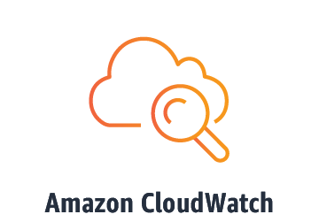
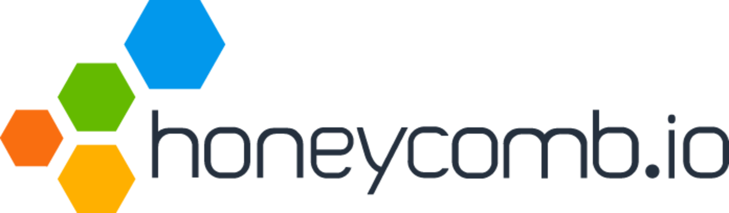
Put Metrics and Traces where they belong
Notes:
Splitting the tools into Logs, metrics, traces
Rise of tools like CloudWatch (for metrics) and Honeycomb (for traces)

Slide 16



Standardization around OpenTelemetry
An investment for the future
Avoid vendor lock-in
Development of shared libraries
Notes:
Christina
Avoiding vendor lock
Make tracing an investment for the future rather than doing tool-specific instrumentation that may end up being thrown away later
Developing shared libraries for common fields, common use cases

Slide 17


Changing the way we measure availability
OR
Is my application up or down?
Notes:
Christina
Very binary, no nuance
Up is good, down is bad
Implied attempt to achieve 100% uptime, an impossible goal

Slide 18
SLIs and SLOs for MyFakeApplication
Category | Service Level Indicator | Service Level Objective
Availability | The proportion of successful requests, as measured from the load balancer metrics. Any HTTP status < 500 is considered successful. | 95% success
Latency | The proportion of sufficiently fast requests, as measured from the load balancer metrics. "Sufficiently fast" is defined as: < 500 ms (for a stricter definition with a lower target), or < 2000 ms (for a second, more lenient definition, which will have a higher target) | 90% of requests < 500 ms 99% of requests < 2000 ms
Notes:
Christina
This is just a hypothetical example
Acceptance of the inevitability of incidents, tolerance for an error budget
Moving away from the “24/7 availability, lowest possible latency” to something more feasible
Improve quality of alerting by notifying based on SLO breaches, budget burndown, etc.
Better impact measurement during incidents. Instead of measuring in minutes (at best) or # of incidents (at worst), now we can measure % of requests impacted… etc.
Assumption: you know your app and can make an informed decision about what “available” means and how available you should be
Opposite of AI Ops magic
How to enable teams and make onboarding easy while challenging them to actually make the decisions themselves
Everyone wants to know ”what the defaults are”

Slide 19
Moving forward from now
How far we’ve come and how far we have left to go

Slide 20

Striking the right balance
Efficiency
Flexibility
Notes:
Christina
Questions emerged that we still need to work through
Theme: tension between recommendations/standardization vs. freedom, flexibility, and deviation from the norm
Standardization reduces re-work and increases efficiency, but limits flexibility and customization

Slide 21
Striking the right balance
Time spent training
Time spent delivering
Notes:
Christina
Questions emerged that we still need to work through
How do we spend the “right” amount of time upskilling and training on these new processes and tools
What is the base level of knowledge that you need to take advantage of a good observability platform
The knowledge bit is key – mention SRE coaching, still figuring this out

Slide 22



Reduce on-premise workloads
Blameless post-incident reviews
Fully observable
Future vision
Notes:
Christina
Current state:
Public Cloud Growth
A large portion of microservices and other key workloads running in AWS
Many deploys every day
Not always multiple per product, but there are dozens of prod deployments daily
Site Reliability Engineering
Logs, metrics, and traces leveraged together, SLIs and SLOs in place
On the road to DevOps
Prod support decentralized, more infra responsibility for product teams
Future state:
Continue to reduce on-premise workloads
Fully observable (OpenTelemetry) – mention a single visualization tool to aggregate the data
Truly blameless post-incident reviews

Slide 23
Thank you!
Notes:
Steve

